Slide 1


Slide 2
About us
We provide a service, Each One Teach One, that aims to connect high school and college students to tutors within their area and encourage face-to-face meetings at mutually convenient locations and timings. Tutors are fellow classmates, or peers who have already taken the same course.
Incentivizes physical meetings by awarding points to students and tutors who choose to meetup at a physical location, which is verified via geotagging technology
A rating based system motivates the tutors to perform better and monitors the quality of their work
Accumulating points and having a good rating reflects positively on resumes
Fosters feelings of fellowship, compassion, kindness, integrity outside of the classroom; “streaks” system builds a strong relationship between a student and a tutor

Slide 3
Application functionalities
A Q&A forum to have questions immediately answered
A profile section that tracks number of points, current level, and maintains general information
A section to connect with tutors in the near vicinity and arrange a meeting via chat
Geotag verification and timer to allocate points

Slide 4
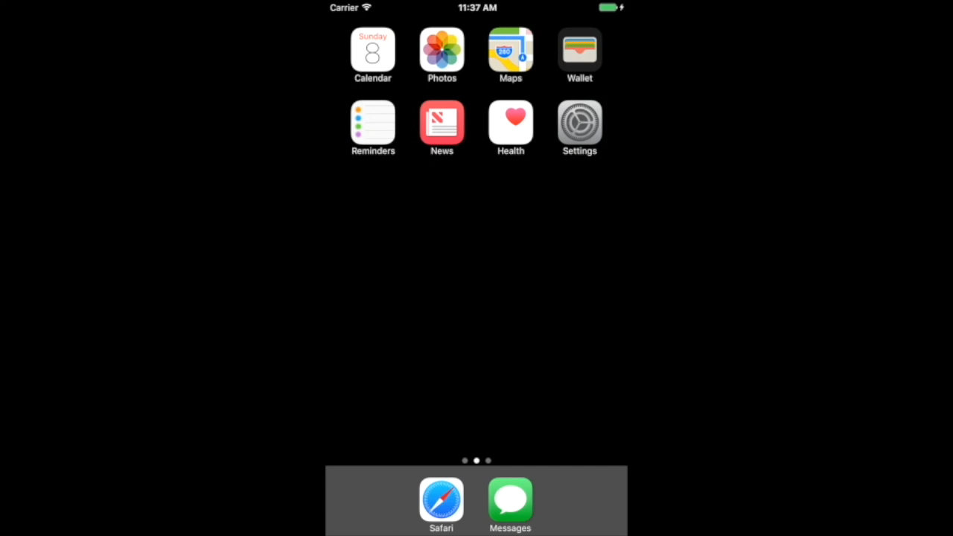

Slide 5
The issue with finding quality tutors
The primary question posed to us during our first presentation was how we would find good tutors.
Asking new tutors who are registering with the service to upload a resume or transcript, and using formfill technology to extract a GPA or certain subject specific grades
Using this information to create an internal ranking system which won’t be displayed to the users, and will disappear once the tutor has gained some experience
Of course, partnering with schools and colleges would give us instant access to student databases, honor societies, and more

Slide 6
Since the hackathon…
Upon on-site research at ASU’s tutoring centers, it was observed that there was a disproportionately high volume of students seeking tutoring on the day of an assignment’s deadline. Tutors feel overwhelmed, and solving the same problem repeatedly gets very monotonous
Our mobile application could enable push notifications to suggest tutoring to students a week before the deadline, for subjects that they frequently seek tutoring for

Slide 7
Designed the Dunces to Dragons website
The website also posts job openings so tutors can quickly access prospective employers based on their rating and number of points

Slide 8
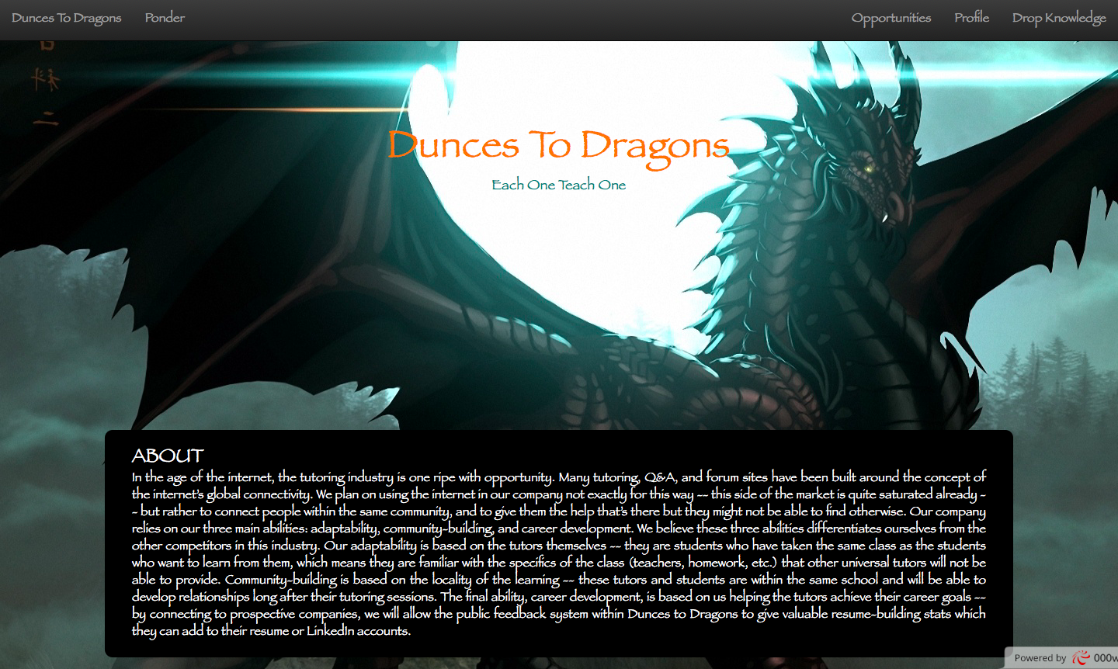

Slide 9
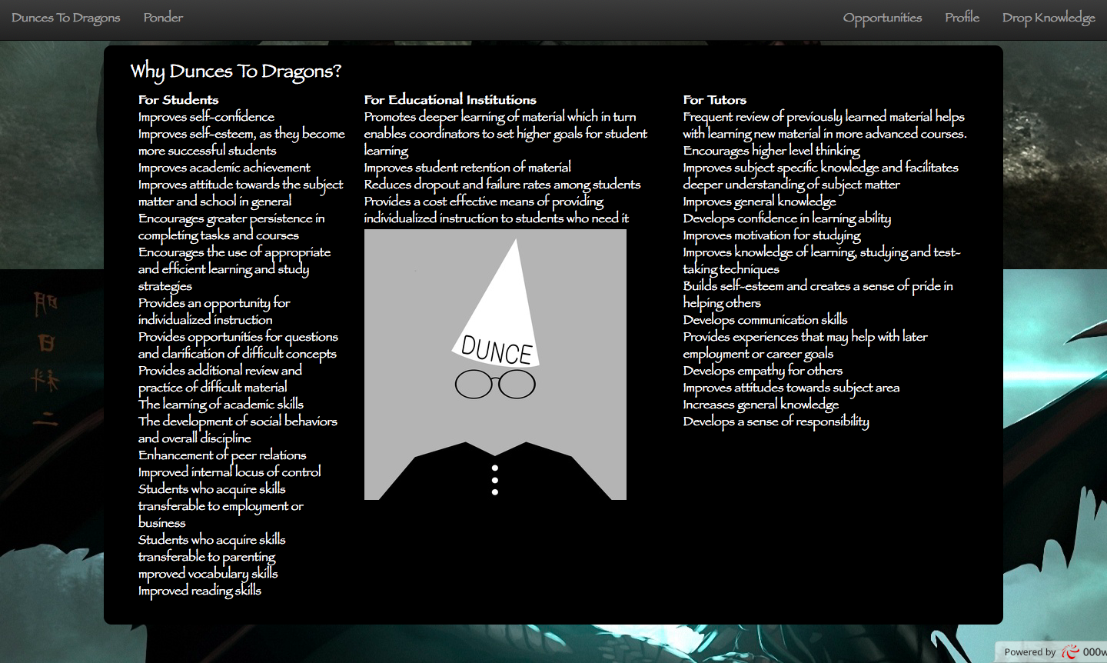

Slide 10
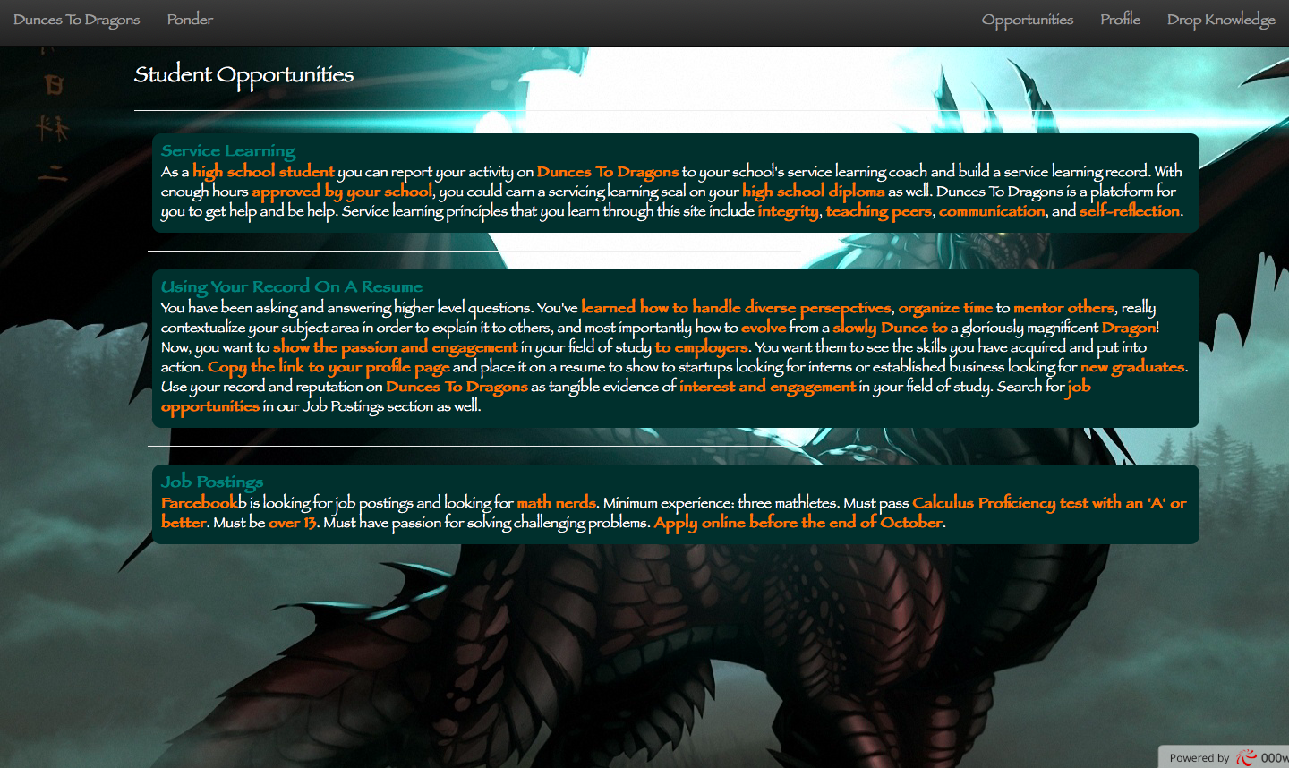

Slide 11
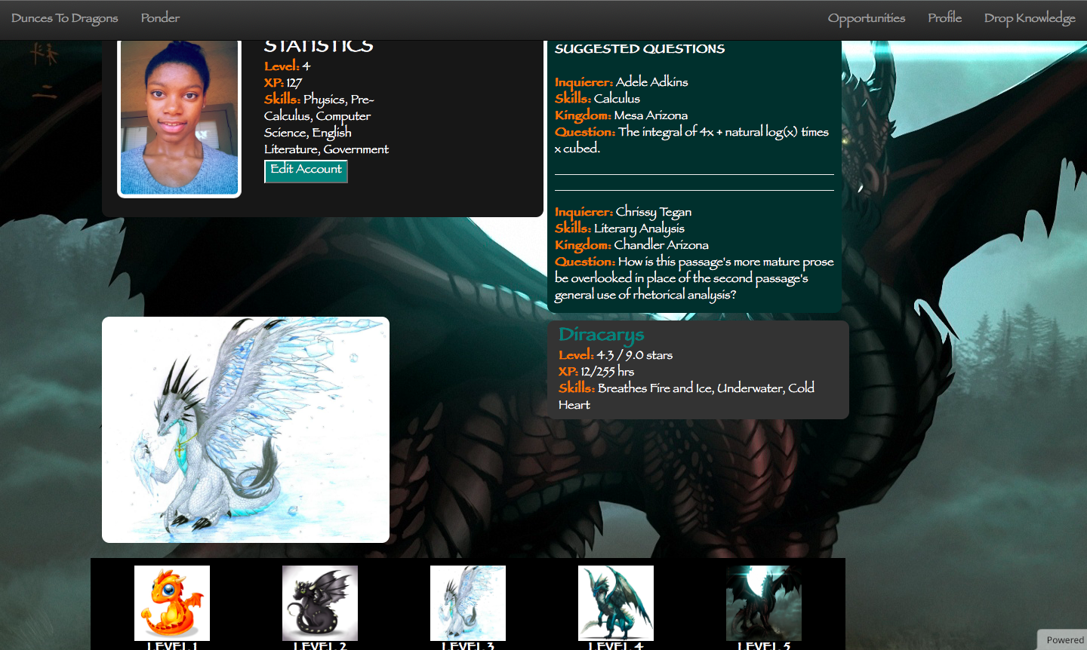

Slide 12
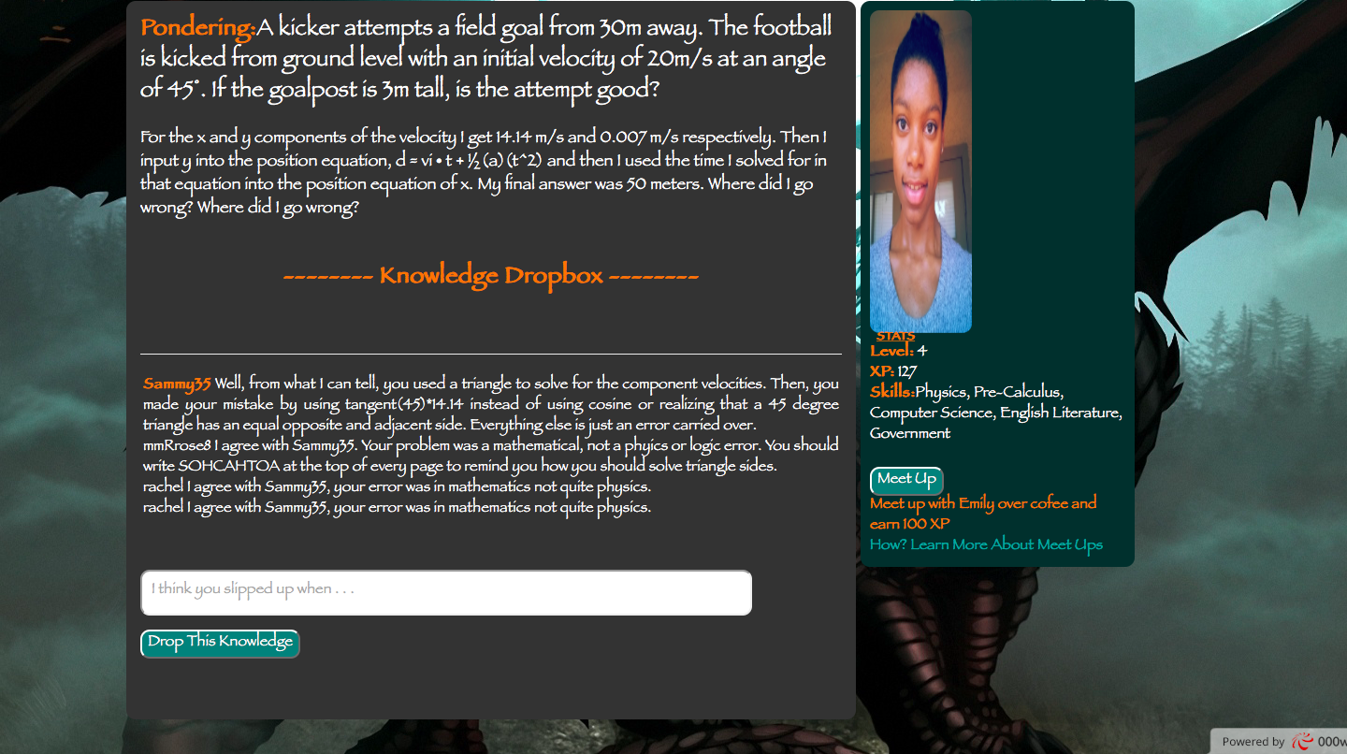

Slide 13
Tentative business model
We plan on financing our first year with a mixture of debt, equity, and personal funds. We are looking at $300,000 for our seed round, selling 3 private shares from a total of 8.
We expect our EPS to be around $15,000 for the first five years. For debt, we plan on leveraging a $75,000 bank loan, which will be paid off in full by 9 years. Our personal funding will stay consistent throughout the 11 year forecast at around $15,000.
We hope to keep relatively 45% gross margins, working on the later years to lower our amount of venture capital investment intake and replace the capital with revenue from our advertising and corporate/university sponsorships. This forecast implies no expansion, staying at five employees with an average yearly salary of $34,000.

Slide 14
Anthony Nicholas
Summer Gautier
Mohit Doshi
Jacob Robinson
Julia Cannon

